Slide 1
Adaptive Air Pressure Regulation System

Slide 2
Problem Statement
What problem are we solving?
Sudden external pressure variations can cause:
Ear discomfort
Fatigue
Reduced situational awareness
Passive ear muffs cannot adapt to dynamic pressure changes
Key Challenge:
Maintain a safe and comfortable pressure difference between the ear cavity and the external environment.

Slide 3
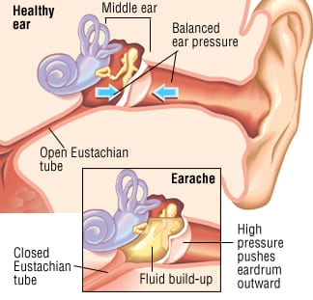
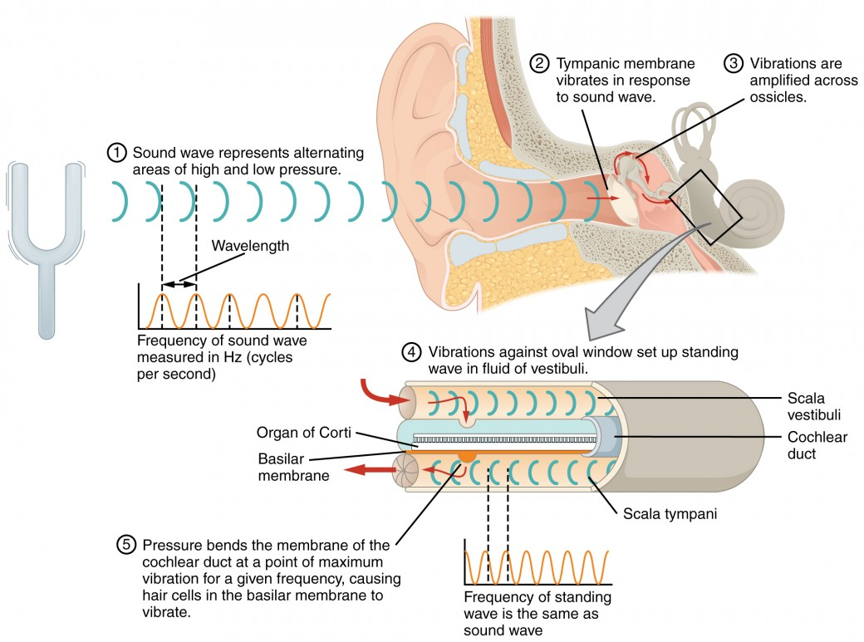
Problem Statement

Slide 4
Proposed Solution (System Overview)
Solution Overview:
Two pressure sensors:
Inside Ear Muff Sensor
Outside Ear Muff Sensor
A solenoid valve to regulate air pressure
Intelligent control logic with timing control
Data logging + Web-based monitoring
High-level idea:
Continuously monitor pressure difference and regulate airflow using a solenoid valve.

Slide 5
Hardware Components
Main Components:
ESP32 Microcontroller
2 × DPS310 Pressure Sensors
Solenoid Valve (Air Vent)
MOSFET / Driver Circuit
Power Supply
Ear Muff Enclosure
Why DPS310?
High-resolution pressure sensing
Suitable for small differential pressure measurement

Slide 6
Sensor Placement Strategy
Sensor Placement:
Sensor 1 (Inside): Measures ear cavity pressure
Sensor 2 (Outside): Measures ambient pressure
Reason:
Enables differential pressure calculation
Eliminates false triggering due to absolute pressure drift

Slide 7

Differential Pressure Principle (Formulas)
Differential Pressure Calculation:
$ΔP=P_{\text{outside}}−P_{\text{inside}}$
Where:
$P_{\text{outside}}$= External pressure
$P_{\text{inside}}$= Pressure inside ear muff
Trigger Condition:
$∣ΔP∣>P_{\text{threshold}}$
If the threshold is crossed → Valve Actuation Starts

Slide 8
Solenoid Valve Control Logic
Valve Actuation Pattern:
ON → 500 ms
OFF → 500 ms
ON → 500 ms
OFF → 500 ms
Then rest period: 5–15 seconds (user-defined)
Purpose:
Gradual pressure equalization
Prevents sudden air bursts
Reduces mechanical wear

Slide 9

Timing Diagram (Formula-Based Explanation)
Total Active Time:
$T_{\text{active}}=4×500 \text{ms}=2000 \text{ms}$
Total Cycle Time:
$T_{\text{cycle}}=T_{\text{active}}+T_{\text{wait}}$
Where:
$T_{\text{wait}}∈\left[5 , 15\right]$seconds (user configurable)

Slide 10
Firmware Architecture
Software Modules:
Sensor Interface (I²C)
Baseline Calibration
Differential Pressure Logic
Valve FSM (Finite State Machine)
SPIFFS File System
Async Web Server

Slide 11
Valve Finite State Machine (FSM)
FSM States:
IDLE
VALVE_ON
VALVE_OFF
WAIT
State Transition Logic:
Based on:
Time elapsed
Pressure difference
User-defined delay

Slide 12
Data Logging using SPIFFS
Why SPIFFS?
Lightweight flash-based file system
No external storage required
Stored Data (CSV):
Timestamp, P_inside, P_outside, Delta_P, Delay_Time, Feedback
Advantages:
Post-analysis
Debugging
Performance evaluation

Slide 13
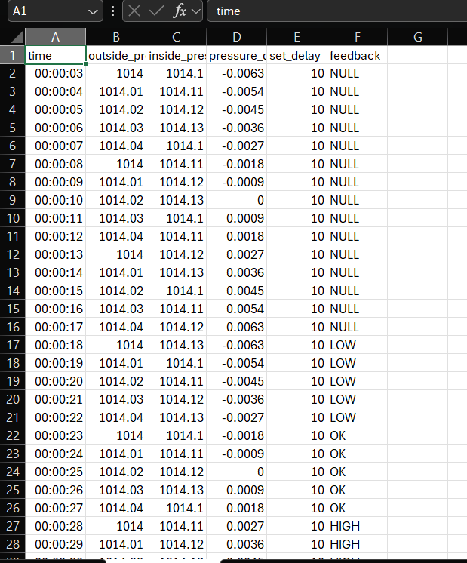
Data Logging using SPIFFS

Slide 14
Web Server & Dashboard
ESP32 Web Server Features:
Real-time pressure display
Valve status
User configuration:
Threshold
Wait time
Technologies Used:
Async Web Server
HTML, CSS, JavaScript

Slide 15
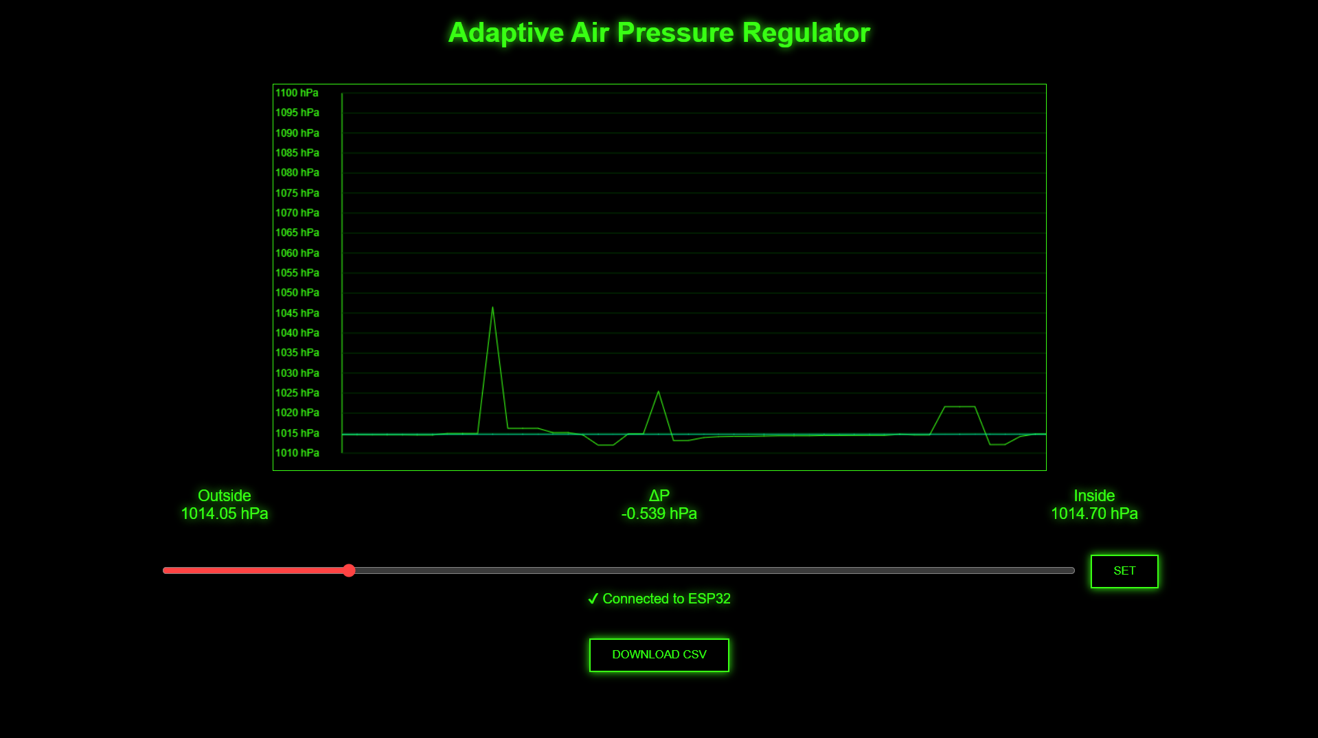
Web Server & Dashboard

Slide 16
Applications
Potential Use Cases:
Industrial safety ear protection
Pilots & aviation ground crew
Construction sites
Research labs

Slide 17
Conclusion & Future Scope
Conclusion:
Intelligent ear protection system
Combines sensing, actuation, and web monitoring
Adaptive & configurable
Future Enhancements:
Closed-loop PID control
Mobile app integration
Miniaturization
ML-based pressure prediction

